Slide 1

Introduction
to
Stored Procedures

Slide 2

User Authorization Process

Slide 3

Role-Based Security Setups

Slide 4

Secured Query Parameters

Slide 5

Monitoring Database Activity

Slide 6
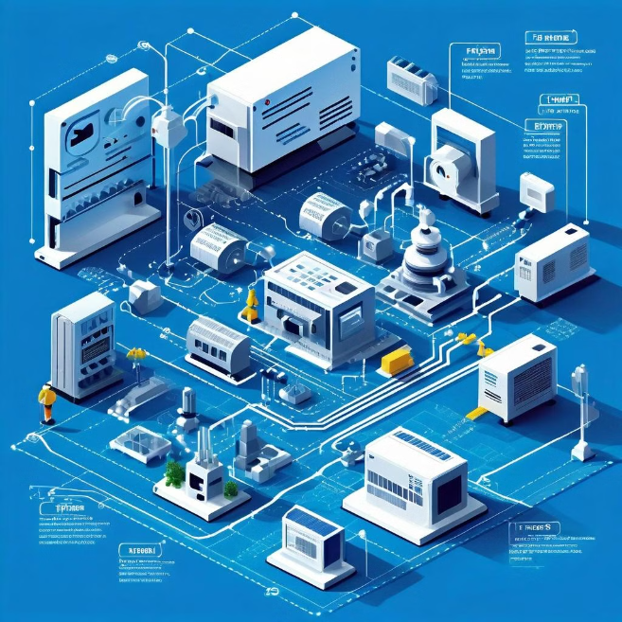
Security Maintenance Plan

